Slide 1
Summary for Compact Sources Working Group
A. Maier & W. Graves
Co-conveners
2012 ICFA Future Light Sources Workshop

Slide 2
Compact Sources Working Group
About 20 people attending on average
Mix of discussion and twelve 30-minute talks
Primary topics were
Laser plasma wakefield accelerators
Inverse Compton scattering properties (keV – MeV photons)
Superconducting RF accelerators
Compact rings
Compact Undulators
Science with compact sources

Slide 3
Scientific Impact of X-ray Sources
The most substantial societal impact of x-rays has come from small scale sources—x-ray tubes (14 Nobel prizes)
Synchrotron radiation has made enormous impact in two ways
Science accomplished (4 Nobel prizes)
Development of extremely powerful methods based on high brilliance
made possible by incoherent emission from relativistic beams
X-ray free-electron lasers will also have enormous impact
Access the fs timescale for the first time with significant flux
Enable the development of methods exploiting the high peak brilliance made possible by coherent electron emission from relativistic beams
Future machine beyond the ultimate single-mode FELs will combine the features of these three generations of sources
Small scale, relativistic e-beams, and coherent emission.
D. Moncton, MIT

Slide 4
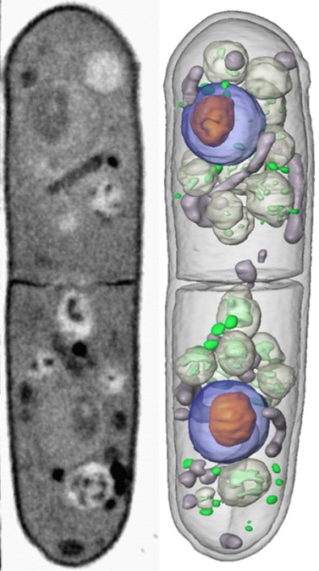
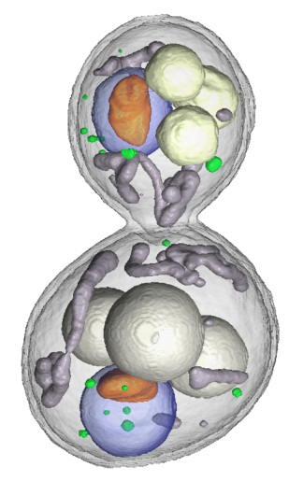
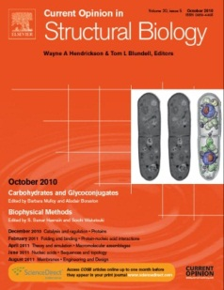
How does compact x-ray light source (CXLS) fit in EMSL/PNNL?
Multi-modality characterization
- Incorporation of EMSL’s capabilities with X-ray capabilities
- i.e., incorporating MS or dynamic TEM capability with x-rays
Controlled radiation damage
- Less intensity in comparison to 4th generation light sources
- Damage in biological materials can be controlled
Time resolved measurements
- Time structure of the pulse width will be in the order of 10-300 fs
- Time scales are consistent with many processes
Special Needs
- High level bio safety, classified work, etc.
Yeast organelle structure
C. Larabell, UCSF/LBNL
With permission.
T. Suntharampillai

Slide 5
F. Albert, LLNL

Slide 6
F. Albert, LLNL

Slide 7
C. Schroeder, LBNL

Slide 8
A Laser-Plasma Driven Undulator
Electron Spectrometer
PM Quadrupoles
X-Rays
Target
Undulator
?
Plasma Target
Laser
delay line
Compact Source
University lab scale X-Ray source at home.
Few-Fs X-Ray Pulses
from few-fs laser-plasma driven electron bunches
Perfect Synchronization
Driver laser serves as ideal pump with fs timing accuracy.
Andreas R. Maier (LMU/MPQ Munich)

Slide 9
M.-E. Couprie, SOLEIL

Slide 10
A. Loulergue, SOLEIL

Slide 11
Super-radiant X-rays via ICS
ICS (or undulator) emission is not a coherent process, scales as N
Super-radiant emission is in-phase spontaneous emission, scales as N²
N electrons
Steps
Emit array of electron beamlets from cathode 2D array of nanotips.
Accelerate and focus beamlet array.
Perform emittance exchange (EEX) to swap transverse beamlet spacing into longitudinal dimension. Arrange dynamics to give desired period.
Modulated electron beam backscatters laser to emit ICS x-rays in phase.
“Intense Super-radiant X-rays from a Compact Source using a Nanocathode Array and Emittance Exchange”
W.S. Graves, F.X. Kaertner, D.E. Moncton, P. Piot
submitted to PRL, published on arXiv:1202.0318v2
W. Graves, MIT

Slide 12
P. Piot, NIU & Fermilab

Slide 13
Superconducting Cavity Design
Above 6 MV is soft barrier
0.65 – 4.5 MV is wide barrier of walking MP. Experiment on prototype is needed to indentify whether it is hard to process. Besides, some levels are especially dangerous:
0.8 MV in zone 1, particles survive for > 150 RF periods with ~200 eV (6th order)
1-1.2 MV in zone 2, particles survive for > 150 RF periods with 50~250 eV (3rd order)
0.65-1.3 MV in zone4, stable one point MP (trapped) with 50~120 eV (3rd order)
So, 0.6-1.3 MV might be strong MP barrier
Plasma cleaning may be used to process away the MP
1: 0.7-2.5 MV
2: 1-2.6 MV
Surviving MP after 20 RF periods
6: 7.6-9 MV
3: 1.3-
3.8 MV
5: 6.1-
9 MV
4: 0.65-4.5 MV
F. He, TJNAF

Slide 14
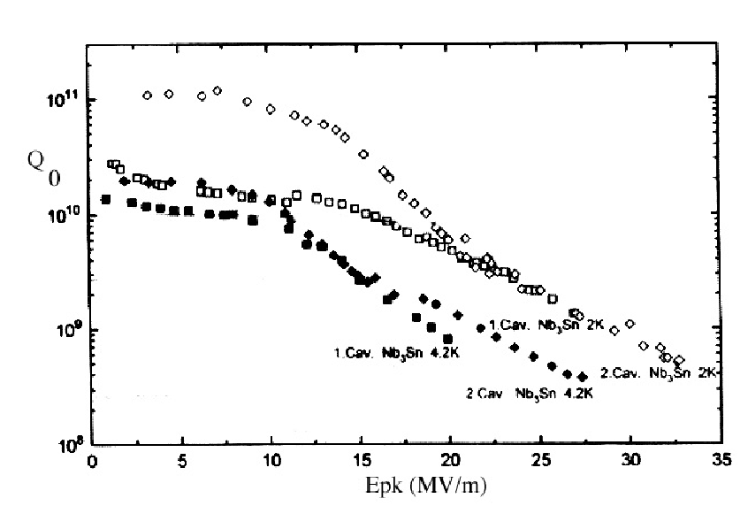
Why Nb₃Sn?
1.5Ghz Elliptical SS at 4.2K
Nb₃Sn
G. Muller and P. Kneisel
350MHZ
Spoke Cavity
at 4.2K
A factor of 10 gained in Qo low fields
But Qo drops at higher fields
J. Mammosser, TJNAF

Slide 15
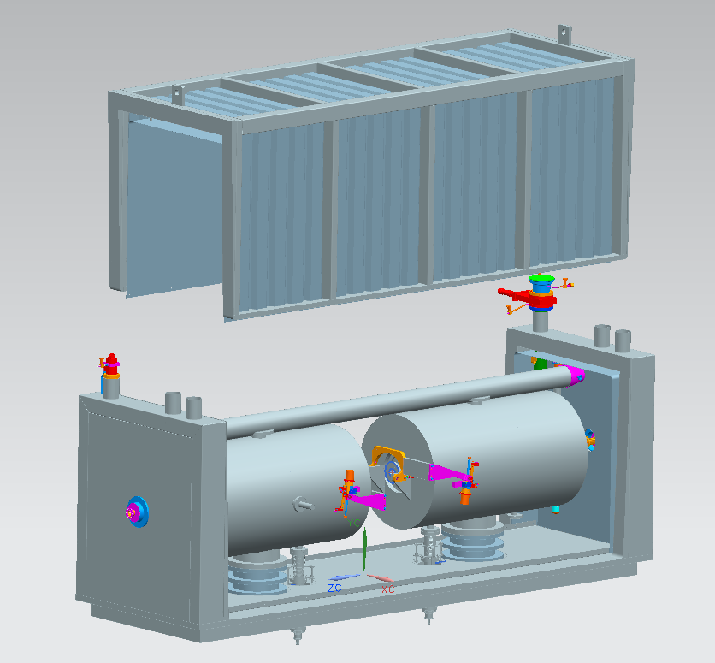
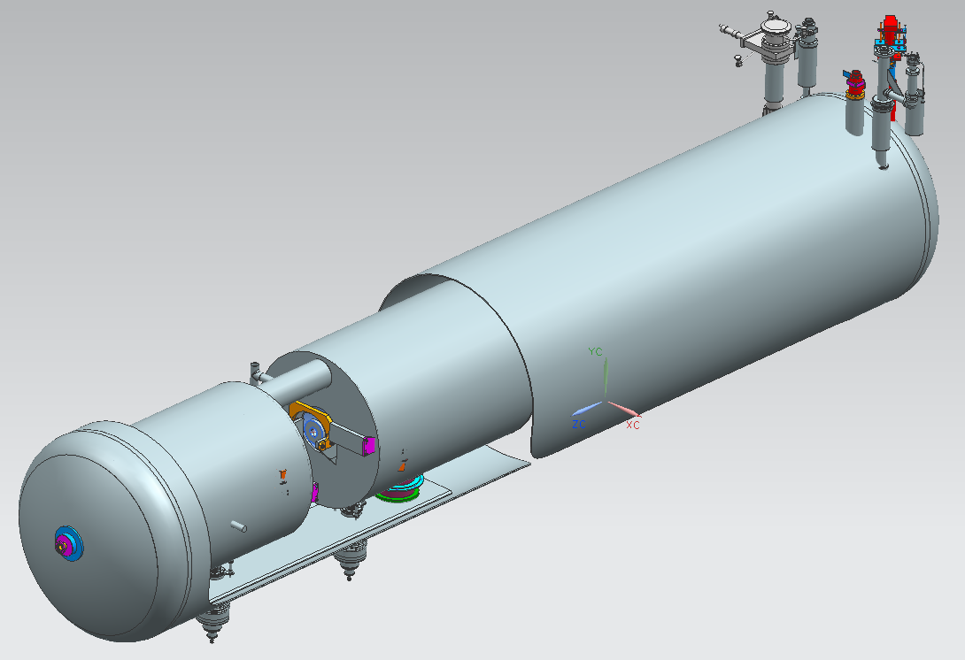
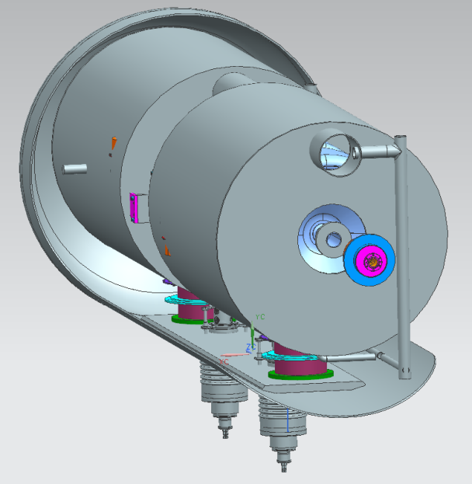
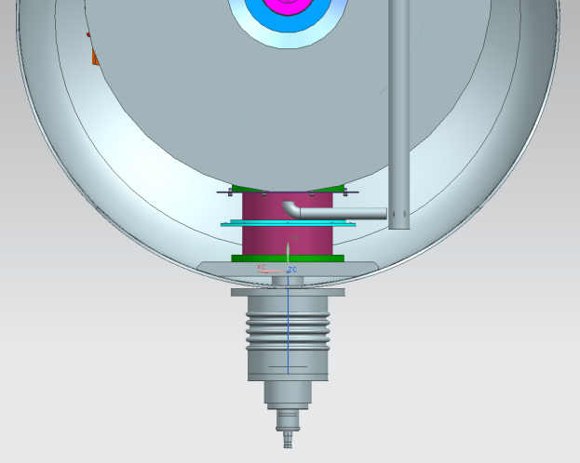
Developing a Low Cost Cryomodule Design
Reviewed cryomodule types
Top Loaded
End Loaded
Bottom Loaded
Two designs are being developed and costs compared
Bottom Loaded
End Loaded
J. Mammosser, TJNAF

Slide 16
G. Travish, UCLA

Slide 17
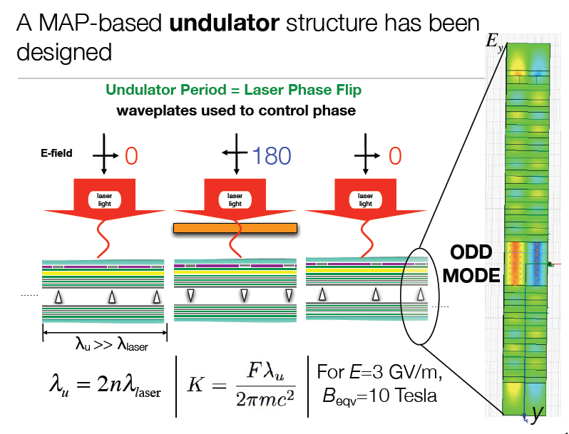
G. Travish, UCLA

Slide 18
D. Arnold, U. Florida

Slide 19
D. Arnold, U. Florida

